Slide 1
Java Essentials

Slide 2
What is Java?
Object Oriented Programming Language.
James Gosling is the father of java language and it is developed by Sun Microsystems.
Hot Java - is the first java enabled web-browser.
First version of java is released in 1995.
Current version: of java 8
Java can be used for developing stand alone applications/web application/mobile application.

Slide 3
Flavours in Java
Standard Edition
Enterprise Edition
Micro Edition

Slide 4
Flavours in Java
Java Standard Edition
Used to develop standalone applications using applet and swings.
Java Enterprise Edition
Used to develop enterprise application using Servlet, JSP, JDBC.
Java Micro Edition
Used to develop application for micro devices like mobile, set up boxes.

Slide 5
Features of Java Language
Simple language as it is similar to C and C++.
Multithreading- can run multiple application at a time.
Portability(platform independence- run on different OS)
Automated Memory management(reclaim the memory of unused objects).
Exception Handling(To handle errors in java)
Write once and run anywhere(WORA)

Slide 6
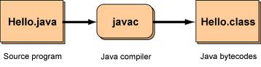
What is Compiler?
Translates the source code(java program) into java class file(byte code).
Checks the syntactical or grammatical errors of the program
The Compiler we use in java is javac developed by Sun Microsystems.
Most Common Java Compilers
javac(Sun Microsystems)
JikesIBM's open Source Compiler)
ECJ(Eclipse Compiler for java)

Slide 7
Application of Java
Desktop Applications such as acrobat reader, media player, antivirus etc.
Web Applications such as irctc.co.in etc.
Enterprise Applications such as banking applications.
Mobile Application
Embedded System
Smart Card
Robotics
Games

Slide 8
Byte Code vs Interpreter
Byte Code
JVM understandable code generated by java compiler.
Interpreter
Java interpreter is a program developed in c or c++ programming language with the name java.
It is responsible for the following tasks
It will converts byte code in to native code line by line.
It will execute the native code.

Slide 9
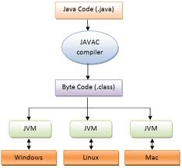
What is JVM?
It is a virtual Machine, platform independent and handles memory management.
It is a specification provided by SUN Microsystems whose implementation provides an environment to run our java application.
Whenever we write a java command on the command prompt to run the java class and instance of JVM is created .JVM is itself called as JRE.
Operations performed by JVM
Loads code
Verifies code
Executes code
Provides runtime environment.
Many vendors has implemented JVM. Some of them are SUN JRE, IBM JRE,ORACLE JRE.

Slide 10
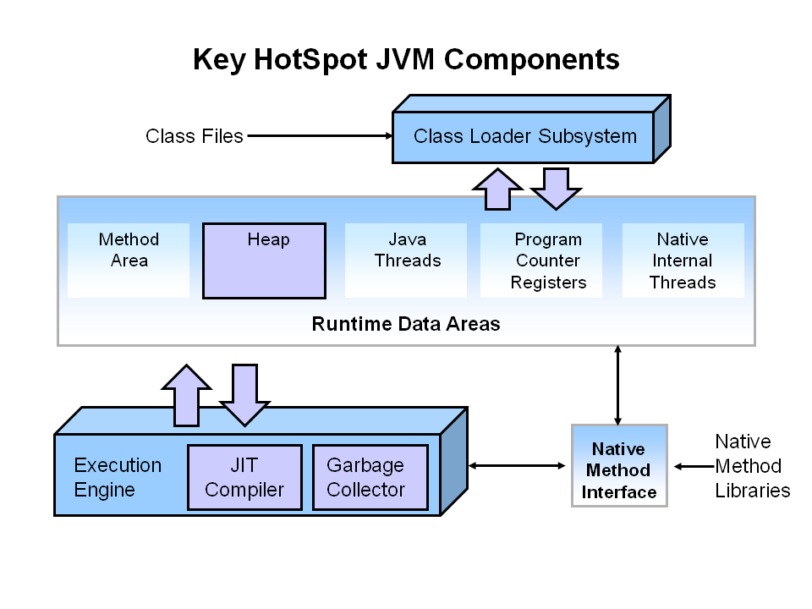
Internal Architecture of JVM?

Slide 11
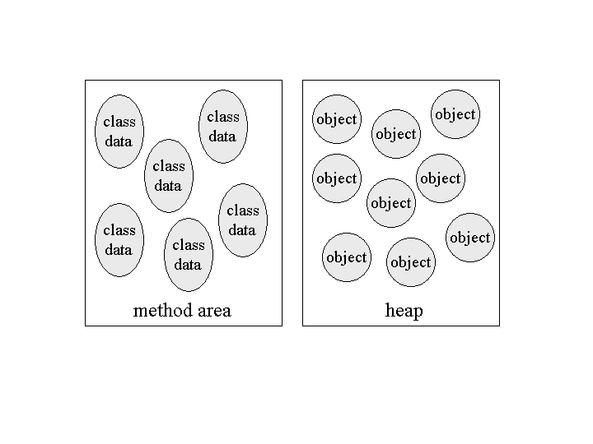
Components of JVM?
Class loader
Loads the .class file from hard disk into RAM.
Verifies all the bytecode instructions,.
Allocate the required memory for the program.
Method area
Stores per-class structures such as the runtime constant pool, field and method data, the code for methods.(i:e stores class code, method code, static variable and static block)
Heap
Runtime data area in which objects are allocated.
PC register
Contains the address of the Java virtual machine instruction currently being executed.

Slide 12
Members of JVM?
Stack
Java Stack stores frames. It holds local variables and partial results, and plays a part in method invocation and return.
Each thread has a private JVM stack, created at the same time as thread.
A new frame is created each time a method is invoked. A frame is destroyed when its method invocation completes.
Native method stack
Contains all the native methods (C,C++ programs and functions) used by your application.
Execution Engine
1) A virtual processor
2) Interpreter: Reads bytecode stream then execute the instructions.
3) Just-In-Time(JIT) compiler
Converts a part of the byte code to native code.
Requires more memory because both byte code and the corresponding native code are in memory at the same time.

Slide 13
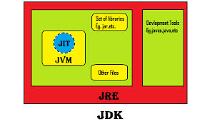
JDK vs JRE
JRE
Stands for Java Runtime Environment. It is the implementation of JVM. It contains set of libraries + other files that JVM uses at runtime.
JDK
JDK is an acronym for Java Development Kit.
It contains JRE + development tools.

Slide 14
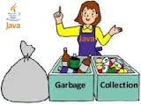
Garbage Collection
Is the process of automatically freeing objects hat are no longer referenced by the program
Is performed in Java by a program called Garbage Collector
Is done automatically
Can vary dramatically across JVM implementations

Slide 15
Quiz
What are the three types of development kits provided by Sun?
a)J2ME
b)J2SE
c)J2EE
2. The JVM for Windows and Linux are same.(True/False)
False. JVM is OS specific
3. Java compiler translates .java source files into ___________?
.exe file b) .bat file c) .doc file d) .class file
4. _________ converts the bytecodes to native code
a) JRE b) JVM c) JIT

Slide 16
Quiz
5. What is the process of automatically freeing objects that are no longer
referenced by the program.
a) Polymorphism b) Garbage Collection c) Encapsulation d) Abstraction
6. An object’s state is defined by _________
and its behavior is defined by__________.
a) class,instance. b) methods,instance variables c) instance variables,methods
7. ___________ is the mechanism that binds together code and the data it manipulates, and keeps both safe from outside Interference and misuse.
a) Polymorphism b) Garbage Collection c) Encapsulation d) Abstraction

Slide 17
Language fundamentals JAVA

Slide 18
Java Language Fundamentals
Character set
Keywords/Reserved words
Identifier/User-Defined words
Data types
Variables
Constants
Literals
Operators
Control Statements
Arrays

Slide 19
Character Set
Alphabets A-Z / a-Z
Digits 0-9
Special Characters #-*&%$!<>{} =~ ^ etc
White Space Character New line(\n),Carriage Return(\r),Tab(\t)
BackSpace(\b)

Slide 20
Keywords/Reserved words
Keywords are simple English words which are having predefined meaning in java.
Meaning of these keywords can’t be modified.
We cant use keywords as names for variables, methods, classes or any other identifiers.
True, false, null are not keywords but reserved as literals.
There are 49 keywords defined up to java 2.
Enum is the new keyword added from Java 5 so there are 50 keywords in java.
Const & goto are the keywords but no implementation available. we cant use these keywords in java program.

Slide 21
List of Keywords
Data types(8) | boolean byte char short int long float double
Class&Objects(9) | class interface enum extends implements this super new instanceof
Access Modifier(3) | Private protected public
Modifier(9) | Final native abstract synchronized transient volatile static const* strictfp
Packages(2) | Package import
Control statements | If else switch case default do while break for continue return goto
Exception Handling(6) | Try catch finally throw throws assert
Other Data type(1) | void

Slide 22
Identifiers/UserDefined Words
Identifiers are the names those will be used to identify the programming elements like classes,methods,variables etc uniquely.
Rules for identifier:
Identifier can contain alphabets,Digits and two special symbols($)Dollar and Underscore(_).
First character of an identifer must be an Alphabet or Dollar($) or Underscore(_).
Keywords or reserved words cant be used as an identifier.
Valid identifiers | Invalid identifiers
Hello | 1stClass
Total_Fee | Student-email

Slide 23
Data types
Data types represents
Type of data we want to use
Amount of memory allocation required for our data.
Types of Data types
1) Primitive Data types
2) User Defined Data types

Slide 24
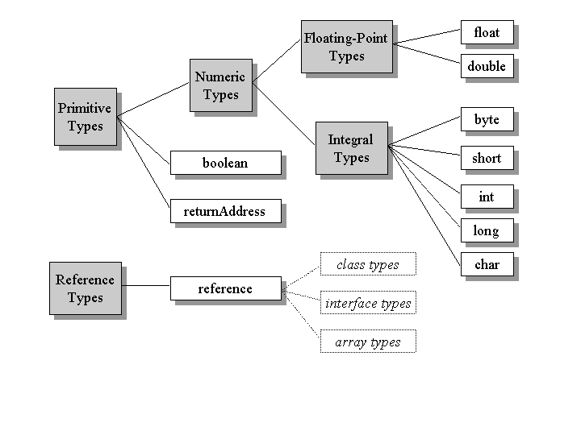
Primitive Data Types

Slide 25
User Defined Datatypes
There are four types of user defined datatypes
1) class type
2) Interface type
3) Enum type( from JAVA 5)
4) Annotation type(from JAVA 5)
Type | Byte | Default value | Min Value | Max Value
Boolean | 1 | False | True or false
Byte | 1 | 0 | -128 | 127
Char | 2 | Ascii-0 unicode-\u00000 | 0 | 65535
Short | 2 | 0 | -32768 | 32767
Int | 4 | 0 | -2147483648 | 2147483647
long | 8 | 0 | -2 ⁶³ | -2 ⁶³⁻¹
Float | 4 | 0.0 | 1.4E-45 | 3.40E38
Double | 8 | 0.0 | 4.9E-324 | 1.79E308
Array reference variable | 8 | Null | Reference to the corresponding type object

Slide 26
Variables
Variable is the container which holds user data.
Memory will be allocated for the variable while executing the program.
Value of the variable can be changed any number of times during the program.
Syntax:
<Datatype> <variable name> = <value>;
Ex:
int a=10; // 4 bytes of memory allocated.
String str=“Ramya”; // 8 bytes of memory allocated.
float a,b,c;
int a=b=c; - initializing same value for multiple variables
int a=100, b=200;

Slide 27
Types of variables
There are two types of variable based on datatype used to declare the variable.
Primitive variable.
Reference variable.
Primitive variable:
Variables declared with primitive data types called primitive variable.
Ex:
int a;
double d1;
double d2=9.9;
float f=3.14f;

Slide 28
Reference variable
Variables declared with user defined data types called reference variables.
Ex:
String str;
String str2=“Java Learning”;
Primitive Variables | Reference Variables
Variables declared with primitive data types | Variables declared with reference datatypes
Memory allocation depends on the data type | Always 8 bytes of memory allocated
Default values depends of primitive data type | Always null assigned as default values
Primitve variables holds valid literals or value in the allocated memory. | Reference variables hold either null or address of an object in the allocated memory.

Slide 29
Types of variables
There are 3 types of variables based upon the scope of the variables.
Instance variable
Static variable
Local variable.
Instance variable
Variables declared in the class without using static keyword.
Static variable
Variables declared with keyword static.
Local variables
Variables declared in the member of the class like method etc.
class hello{
int a;
static int b;
void show(){
int c;
} }

Slide 30
Constants
Constant is a variable whose value cant be changed during the program execution.
Constant is also as final variable.
Syntax:
[modifier]final<data type><variablename>=<value>
Ex:
final int a=99;
final string name=“Revathi”;
final double d1=444.555;
A variable that is declared as final and not initialized is called as blank final variable.
Ex:
final int A;
A=100;
If the variable is declared as final and initialized in the same statement then in the class file compiler will replace that variable with actual value.

Slide 31
Literals
Literals are actual values.
Literals will be assigned to variables or constants.
Literals are also used to perform any operations.
Constant values in programs are called as literals.
Ex:
int a=100;
float pi=3.14f; - Float literals.
Boolean b1=true - Boolean literals.
Char ch=‘A’; - Character literals.
String s=“sasi” - String literals.
integer Literals

Slide 32
Operators
Operators are used to perform operations by using operands.
There are 3 types of operator.
Unary Operator - Only one operand is required.
Bitwise Operator - Only two operands is required.
Ternary Operator - Three operands is required.
Operatiors in java
Arithmetic Operator
Assignment Operator
Increment and Decrement Operator
Logical Operator
Relational Operator
Bitwise Operator
Class and Object Operator
Other Operator
Operator Precedence

Slide 33
Arithmetic Operators
Operator | Use | Example
+ | Addition | a+b
- | Subtraction | a-b
* | Multiply | a*b
/ | Divide | a/b – retuns Quotient
% | Modulus | a%b - returns remainder

Slide 34
Increment and Decrement Operator
Operator | Use
x++ | Post-increment : add 1 to the value. The value is returned before the increment is made, e.g. x = 1; y = x++; Then y will hold 1 and x will hold 2
x- - | Post-decrement : subtract 1 from the value. The value is returned before the decrement is made, e.g. : x = 1; y = x--; Then y will hold 1 and x will hold 0.
++x | Pre-increment : add 1 to the value. The value is returned after the increment is made, e.g. x = 1; y = ++x; Then y will hold 2 and x will hold 2.
++x | Pre-increment : add 1 to the value. The value is returned after the increment is made, e.g. x = 1; y = ++x; Then y will hold 2 and x will hold 2.
--x | Pre-decrement : subtract 1 from the value. The value is returned after the decrement is made, e.g. x = 1; y = --x; Then y will hold 0 and x will hold 0.

Slide 35
Logical Operators
Boolean Operators x and y are boolean types. x and y can be expressions that result in a boolean value. Result is a boolean true or false value.
x && y | Conditional AND | If both x and y are true, result is true. If either x or y are false, the result is false If x is false, y is not evaluated.
x & y | Boolean AND | If both x and y are true,the result is true. If either x or y are false, the result is false Both x and y are evaluated before the test.
x || y | Conditional OR | If either x or y are true, the result is true. If x is true, y is not evaluated.
x | y | Boolean OR | If either x or y are true, the result is true. Both x & y are evaluated before the test.
!x | Boolean NOT | If x is true, the result is false. If x is false, the result is true.
x ^ y | Boolean XOR | If x is true and y is false, the result is true. If x is false and y is true, the result is true. Otherwise, the result is false. Both x and y are evaluated before the test.

Slide 36
Assignment Operators
= | Assignment operator. x = y; y is evaluated and x set to this value. The value of x is then returned.
+=, -=, *=, /=, %= | Arithmetic operation and then assignment, e.g. x += y; is equivalent to x = x + y;
&=, |=, ^= | Bitwise operation and then assignment, e.g. x &= y; is equivalent to x = x & y;
<<=, >>=, >>>= | Shift operations and then assignment, e.g. x <<= n; is equivalent to x = x << n;

Slide 37
Relational Operator
x < y | Is x less than y ?
x <= y | Is x less than or equal to y ?
x > y | Is x greater than y ?
x >= y | Is x greater than or equal to y ?
x == y | Is x equal to y ?
x != y | Is x not equal to y ?

Slide 38
Class and Object Operators
x instanceof c | Class Test Operator | The first operand must be an object reference. c is the name of a class or interface. If x is an instance of type c or a subclass of c, then truereturned. If x is an instance of interface type c or a sub-interface, thentrue is returned. Otherwise, false is returned.
new c(args) | Class Instantiation | Create an instance of class c using constructor c(args)
"." | Class Member Access | Access a method or field of a class or object : o.f - field access for object o o.m() - method access for object o
() | Method Invocation | Parentheses after a method name invokes (i.e. calls) the code for the method, e.g. o.m() o.m(x,y)
(c) | Object Cast | Treat an object as the type of class or interface c: c x=(c)y; Treat y as an instance of class or interface c
+ | String Concatenation | This binary operator will concatenate one string to another. E.g. String str1 = "abc"; String str2 = "def"; String str3 = str1 + str2 results in str3 holding "abcdef". For mixed operands, if either a or b in (a + b) is a string, concatenation to a string will occur. Primitives will be converted to strings and the toString() methods of objects will be called. (This is the only case of operator overloading in Java.) Note that the equivalence operator "+=" will also perform string concatenation.
[] | Array Element Access | In Java, arrays are classes. However, the bracket operators work essentially the same as in the C/C++. To access a given element of an array, place the number of the element as an int value (long values cannot be used in Java arrays) into the brackets, e.g. float a = b[3]; int n = 5; char c=c[n]; where b is a float array and c is a char array.

Slide 39
Other Operators
Other Operators
x=boolean?y:x | Conditional Operator | The first operand - boolean - is a boolean variable or expression. First this boolean operand is evaluated. If it is true then the second operator evaluated and x is set to that value. If the boolean operator is false, then the third operand is evaluated and x is set to that value.
(primitive type) | Type Cast | To assign a value of one primitive numeric type a more narrow type, e.g. long to int, an explicit cast operation is required, e.g. long a = 5; int b = (int)a;

Slide 40
Quiz
1. Which one of these lists contains only Java programming language keywords?
A. class, if, void, long, Int, continue
B. goto, instanceof, native, finally, default, throws
C. try, virtual, throw, final, volatile, transient
D. strictfp, constant, super, implements, do
byte, break, assert, switch, include
2. Which is a valid keyword in java?
A.Interface B.string C.Float D.unsigned
3. Which one is a valid declaration of a boolean?
A. boolean b1 = 0;
B. boolean b2 = 'false';
C. boolean b3 = false;
D. boolean b4 = Boolean.false();
E. boolean b5 = no

Slide 41
Quiz
4. Which is a valid declarations of a String?
A. String s1 = null;
B. String s2 = 'null';
C. String s3 = (String) 'abc';
String s4 = (String) '\ufeed
5. What is the numerical range of a char?
A. -128 to 127 B. -(215) to (215) - 1
C. 0 to 32767 D. 0 to 65535
1.B
2.A
3.C
4.A
5.D

Slide 42
Control Structures

Slide 43
Introduction
There are two types of Control structures in Java
Decision Making Statements
Looping /Repetitive Statement

Slide 44
Decision Making Statements
There are two types of decision making statements in Java. They are:
if statements
switch statements

Slide 45
if Statement
An if statement consists of a Boolean expression followed by one or more statements.
Syntax:
if(Boolean_expression) {
//Statements will execute if the Boolean expression is true
}
Works:
If the boolean expression evaluates to true then the block of code inside the if statement will be executed. If not the first set of code after the end of the if statement(after the closing curly brace) will be executed

Slide 46
Program
public class Test {
public static void main(String args[]){
int x = 10;
if( x < 20 ){
System.out.print("This is if statement");
}
}
}
Output:
This is if statement

Slide 47
if...else Statement
An if statement can be followed by an optional else statement, which executes when the Boolean expression is false.
Syntax:
if(Boolean_expression){
Executes when the Boolean expression is true
}
else
{
Executes when the Boolean expression is false
}

Slide 48
Program
public class Test {
public static void main(String args[]){
int x = 30;
if( x < 20 ){
System.out.print("This is if statement");
}
else{
System.out.print("This is else statement");
}
}
}
Output:
This is else statement

Slide 49
if...else if...else Statement
An if statement can be followed by an optional else if...else statement, which is very usefull to test various conditions using single if...else if statement.
Syntax:
if(Boolean_expression 1){
//Executes when the Boolean expression 1 is true
}
else if(Boolean_expression 2){
//Executes when the Boolean expression 2 is true
}
else if(Boolean_expression 3){
//Executes when the Boolean expression 3 is true
}
else {
//Executes when the none of the above condition is true.
}

Slide 50
Program
public class Test {
public static void main(String args[]){
int x = 30;
if( x == 10 ){
System.out.println("Value of X is 10");
}else if( x == 20 ){
System.out.println("Value of X is 20");
}else if( x == 30 ){
System.out.println("Value of X is 30");
}else{
System.out.println("This is else statement");
}
}
}
Output: Value of X is 30

Slide 51
Nested if...else Statement
It is always legal to nest if-else statements, which means you can use one if or else if statement inside another if or else if statement.
Syntax:
if(Boolean_expression 1){
Executes when the Boolean expression 1 is true
if(Boolean_expression 2){
Executes when the Boolean expression 2 is true
}
}

Slide 52
Program
public class Test {
public static void main(String args[]){
int x = 30;
int y = 10;
if( x == 30 ){
if( y == 10 ){
System.out.print("X = 30 and Y = 10");
}
}
}
Output: X = 30 and Y = 10

Slide 53
switch Statement
A switch statement allows a variable to be tested for equality against a list of values. Each value is called a case, and the variable being switched on is checked for each case.
Syntax:
switch(expression){
case value :
Statements
break; //optional
case value :
Statements
break; //optional
You can have any number of case statements.
default :
//Optional
//Statements
}

Slide 54
Program
public class Test {
public static void main(String args[]){
char grade = 'A';
switch(grade)
{
case 'A' :
System.out.println("Excellent!");
break;
case 'B' :
case 'C' :
System.out.println("Well done");
break;
case 'D' :
System.out.println("You passed");
case 'F' :
System.out.println("Better try again");
break;
default :
System.out.println("Invalid grade");
}
System.out.println("Your grade is " + grade);
} }

Slide 55
Introduction to Loops in Java
There may be a situation when we need to execute a block of code several number of times, and is often referred to as a loop.
Java has very flexible three looping mechanisms. You can use one of the following three loops:
while Loop
do...while Loop
for Loop

Slide 56
while Loop
A while loop is a control structure that allows you to repeat a task a certain number of times.
Syntax:
while(Boolean_expression)
{
Statements;
}
Working Procedure:
When executing, if the boolean_expression result is true then the actions inside the loop will be executed. This will continue as long as the expression result is true.

Slide 57
Program
public class Test {
public static void main(String args[]) {
int x = 10;
while( x < =15 ) {
System.out.print("value of x : " + x );
x++;
System.out.print("\n");
}
}
}
Output:
value of x : 10
value of x : 11
value of x : 12
value of x : 13
value of x : 14
value of x : 15

Slide 58
do...while Loop
do...while loop is similar to a while loop, except that a do...while loop is guaranteed to execute at least one time.
Syntax:
do{
Statements;
}while(Boolean_expression);
Note:
Notice that the Boolean expression appears at the end of the loop, so the statements in the loop execute once before the Boolean is tested.

Slide 59
Program
public class Test {
public static void main(String args[]){
int x = 10;
do{
System.out.print("value of x : " + x );
x++;
System.out.print("\n");
}while( x < 15 );
}
}
Output:
value of x : 10
value of x : 11
value of x : 12
value of x : 13
value of x : 14

Slide 60
for Loop
A for loop is a repetition control structure that allows you to efficiently write a loop that needs to execute a specific number of times.
Syntax:
for(initialization; Boolean_expression; update)
{
Statements
}

Slide 61
Program
public class Test {
public static void main(String args[]) {
for(int x = 10; x < 15; x = x+1) {
System.out.print("value of x : " + x );
System.out.print("\n");
}
}
}
Output:
value of x : 10
value of x : 11
value of x : 12
value of x : 13
value of x : 14

Slide 62
break Keyword
The break keyword is used to stop the entire loop. The break keyword must be used inside any loop or a switch statement.
Syntax:
break;
public class Test {
public static void main(String args[]) {
int [ ] numbers = {10, 20, 30, 40, 50};
for(int x : numbers ) {
if( x == 30 ) {
break;
}
System.out.print( x );
System.out.print("\n");
}
}
}

Slide 63
continue Keyword
The continue keyword can be used in any of the loop control structures. It causes the loop to immediately jump to the next iteration of the loop.
Syntax:
continue;
public class Test {
public static void main(String args[]) {
int [] numbers = {10, 20, 30, 40, 50};
for(int x : numbers ) {
if( x == 30 ) {
continue;
}
System.out.print( x );
System.out.print("\n");
}
}
}

Slide 64
Arrays
Array is a collection of similar type of elements of same data type.
Class B{
public static void main(String[] args){
int a[]=new int[5]; //declaration and instantiation of array.
a[0]=10; //initialization of array
a[1]=20;
a[2]=30;
a[3]=40;
a[4]=50;
//Printing array elements
for(int i=0;i<a.length;i++){
System.out.println(a[i]);
}
}
Output: 10 20 30 40 50

Slide 65
Declaration, instantiation, initialization of Array
int a[]={10,20,40,50,60};
Example:
Class B{
public static void main(String[] args){
int a[]={33,44,55};// declaration, instantiation and initialization of array
//Printing array elements
for(int i=0;i<a.length;i++){
System.out.println(a[i]);
}
}
Output: 33 44 55

Slide 66
Multidimenstional array
To store the data in rows and Columns.
Syntax:
datatype[][]=new int[rows][columns];
Example:
int a[][]=new int[3][3];

Slide 67
Program
Class B{
public static void main(String[] args){
int a[][]={{1,2,3},{2,4,5},{4,4,5}};//declaration and instantiation of array.
//Printing 2d array elements
for(int i=0;i<3;i++){
for(int j=0;j<3;j++){
System.out.print(a[i][j]);
}
System.out.println();
}
}
}
Output:
1 2 3
2 4 5
4 4 5

Slide 68
Strings
String is a sequence of characters enclosed in double quotes.
Example:
String s1=“Welcome to Java Programming”;
Note:
Here String is nothing but it’s a class.
Program
class Test{
public static void main(String[] args){
String s1=“welcome to Java Programming”;
System.out.println(s1);
}
}
Output: Welcome to java Programming

Slide 69
Quiz
1.public void test(int x)
{
int odd = 1;
if(odd) /* Line 4 */
{
System.out.println("odd");
}
else
{
System.out.println("even");
}
}
Which statement is true?
A. Compilation fails.
B. "odd" will always be output.
C. "even" will always be output.
D."odd" will be output for odd values of x, and "even" for even values.
Ans: The compiler will complain because of incompatible types (line 4), the if expects a boolean but it gets an integer.

Slide 70
Quiz
2. public class While
{
public void loop()
{
int x= 0;
while ( 1 ) /* Line 6 */
{
System.out.print("x plus one is " + (x + 1)); /* Line 8 */
}
}
}
Which statement is true?
A. There is a syntax error on line 1.
B. There are syntax errors on lines 1 and 6.
C. There are syntax errors on lines 1, 6, and 8.
There is a syntax error on line 6.
Explanation
Using the integer 1 in the while statement, or any other looping or conditional construct for that matter, will result in a compiler error. This is old C Program syntax, not valid Java.

Slide 71
Quiz
switch(x)
{
default:
System.out.println("Hello");
}
Which two are acceptable types for x?
Byte b) long c) char d) float e) Short f) Long
A. 1 and 3 B. 2 and 4
C. 3 and 5 D. 4 and 6
Explanation
Switch statements are based on integer expressions and since both bytes and chars can implicitly be widened to an integer, these can also be used. Also shorts can be used. Short and Long are wrapper classes and reference types can not be used as variables

Slide 72
OOPS

Slide 73
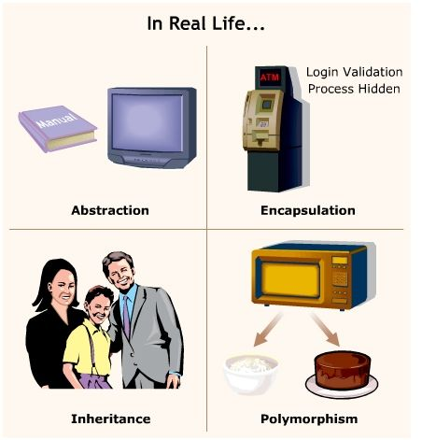
OOPS

Slide 74
Class and Objects
A class is an expanded concept of a structure. i.e: instead of holding only data; class can hold both data and functions.
Class contains logical description of real world entity in terms of State and Behaviour.
Class= State + Behaviour
Class is a prototype or template or pattern or blueprint of Object’s State and behaviour.
Syntax:
[modifier]class <classname>
{
// Members of class
}
class customer{
int cid;
string cname;
long phone;
void show()
{
- -
}
}

Slide 75
Class continued…
Class is a keyword and class name is used for creating objects.
Class contains two parts variable declaration and method declaration.
variable declaration represents what type of data members we use as part of the class.
Method declaration represents the type of methods which we use as part of the class to perform operations.
There are two types of methods inside the class Member method and Non- member methods.
Member methods
It comes under the scope of the class in java. We use only member methods inside a java class.
Non member methods
These methods does not comes under the scope of the class .Java does not
allow non-members at all.

Slide 76
Class continued…
Note:
In JAVA memory space for the data members will be creating on heap memory (Dynamic memory).
Memory space for methods will be creating on stack memory (that too when we call the methods).
constants of any JAVA program is available in associative memory (retrieving data from associative memory is negligible).
The class definition exists only one time but whose objects can exists many number of times i.e., a class is acting as a formula form.

Slide 77
Object
In order to store the data for the data members of the class we must create an object.
Instance(instance is a mechanism of allocating sufficient memory space for data members of a class) called object.
Syntax:
<className><refVarName>= new <className>();
Ex:
Customer c1=new Customer();
Customer c2=new Customer();
Customer c3=new Customer();
Note:
JAVA allows dynamic memory allocation. In order to create memory space in JAVA we must use an operator new .This operator is called dynamic allocation operator.
Classname() represents constructor.

Slide 78
Object continued…
c1
class customer{
int cid;
string cname;
long phone;
void show()
{
- -
}
}
c2
c3

Slide 79
Contined…
What happens inside JVM when an Object is created.
Customer c1=new Customer();
1.Allocated 8 bytes of memory for the reference variable and initializes to null.
c1
null
2. Verifies whether is class loaded or not and loads the class initializes the class.
3. Creates an object and initializes the instance variable with default values.
99723
c1
cname
phone
cid
99723
0
null
0

Slide 80
Continued…
Class | Object
A class is a way of binding the data and associated methods in a single unit. | Class variable is known as an object
Whenever we start executing a JAVA program, the class will be loaded into main memory with the help of class loader subsystem (a part of JVM) only once. | After loading the class into main memory, objects can be created in n number
When the class id defined there is no memory space for data members of a class. | When an object is created we get the memory space for data members of the class.

Slide 81
Encapsulation
“Data encapsulation is the process of wrapping up on data and associated methods in a single unit”.
Data encapsulation is basically used for achieving data/information hiding i.e.security.
When we want to send the data from client to the server we must always send in the form of JAVA object only. Since, by default the JAVA object is in encrypted form (we should not send the data from client to the server in the form of fundamental data).

Slide 82
Inheritance
Inheritance is the process of taking the features(data members+methods) from one class to another class.
The existing class is called the parent/super/base class
The derived class is called the child/sub /derived class
The child inherits characteristics, i.e. the methods and data defined from the parent class.
A class can only extend one base class.
All Java classes are extended from a common base class (java.lang.Object) automatically.

Slide 83
Data abstraction
Data abstraction is a mechanism of retrieving essential details without dealing with background details.
In real world we have three levels of abstractions. They are physical level abstraction, conceptual/logical level abstraction and view level abstraction.
Physical level abstraction is one; it always deals with physical organization architecture of the application. For example in real world an application designing of any problem comes under physical level abstraction.eg: EmpTable
Empno | Empname | sal
Conceptual/logical level abstraction is one it always deals with what kind of data we are entering without dealing with physical architecture of the application. For example, entering the data into the database, writing the coding and applying testing principle comes under conceptual level abstraction.
View level abstraction deals with what kind of data we are retrieving without dealing with both conceptual level abstraction and physical level abstraction. For example retrieving data from the data base in various combinations. All internet users come under view level abstraction.

Slide 84
Polymorphism
Polymorphism is a process of representing "one form in many forms".
In object oriented programming’s we have two types of polymorphism
They are
Compile time polymorphism
Run time polymorphism.
JAVA does not support compile time polymorphism(method overloading)
JAVA supports only run time polymorphism(method overriding)

Slide 85
Members of Class
Following members can be defined in a class
1) Variables (static or instance )
2) Blocks( static or instance)
3) Constructors
4) Methods (static or instance )
5) Inner Classes

Slide 86
Static Block
Static blocks are called as static initialization block(SIB).
Static block is a block of code enclosed in { } and preceded by static keyword.
A class can have any number of static initialization blocks, and they can appear anywhere in the class body.
This block gets executed when the class is loaded in the memory by JVM.
A class can have multiple Static blocks, which will execute in the same sequence in which they have been written into the program.
Program
Class A{
A()
{
System.out.println(“Constructor is invoked”); →3
}
static{
System.out.println(“Static block is involved”);→1
}
Public static void main(String[] args){
System.out.println(“Hello main”); →2
A obj=new A();
}
}

Slide 87
Instance initilization Block(IIB)
Block defined inside the class directly without static modifier is called as instance initialization block and used to initialize instance data member.
An instance initialization block runs once every time a new instance is created.
Execution order depends on the order you declare them.
When you have multiple constructors or overloaded constructors in your class, And you have certain common operation or initialization in each constructor then you can write those common operations in instance initialization block.
Instance init blocks executes before the constructor of that class invoked

Slide 88
Program
class InitBlock
{
InitBlock(int x){System.out.println(“1 Arg Constructor”);}
InitBlock(){System.out.println(“0 Arg Constructor”);}
static{System.out.println(“1st Static Init Block”);}
{System.out.println(“1st Instance Init Block”);}
{System.out.println(“2nd Instance Init Block”);}
static{System.out.println(“2nd Static Init Block”);}
public static void main(String[] args)
{
new InitBlock();
new InitBlock(2);
}
}
Output
1st Static Init Block
2nd Static Init Block
1st Instance Init Block
2nd Instance Init Block
0 Arg Constructor
1st Instance Init Block
2nd Instance Init Block
1 Arg Constructor

Slide 89
Program
class A{
A(){
System.out.println("parent class constructor invoked");
}
}
class B extends A{
B(){
super();
System.out.println("child class constructor invoked");
}
{System.out.println("instance initializer block is invoked");}
public static void main(String args[]){
B b=new B();
}
}
Output:
parent class constructor invoked
instance initializer block is invoked
child class constructor invoked

Slide 90
Static Variable
Static variables are also known as Class Variables declared with keyword static. Such variables get default values based on the data type.
Data stored in static variables is common for all the objects( or instances ) of that Class.
Memory allocation for such variables only happens once when the class is loaded in the memory.
These variables can be accessed in any other class using class name.
Unlike non-static variables, such variables can be accessed directly in static and non-static methods.

Slide 91
Concept behind Static Variable –saves memory
Class student{
int rollno;
String name;
String college=“Anna University”;
}
Note:
Suppose there are 500 students in my college, now all instance variable will get memory each time when a object is created.
All students have unique rollno, unique name so declaring without keyword static is good practice.
Here college refers to common property for all the objects. So if we make it as static means this field will gets memory once.(i.e) static keyword is shared by all objects of the class.

Slide 92
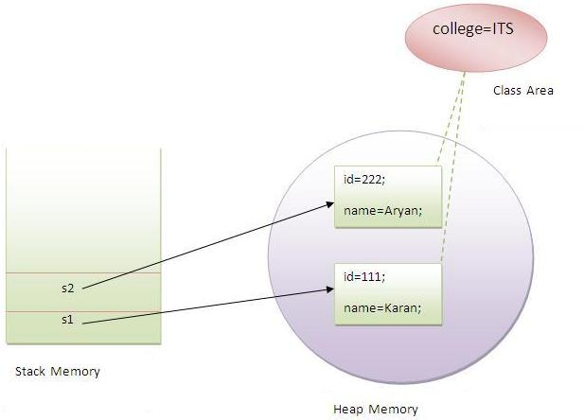
Program for static variable
class student{
int rollno;
String name;
static String college="ITS";
student(int r,String n){
rollno=r;
name=n;
}
void display(){
System.out.println(rollno+""+name+"'+college);
}
public static void main(String[] args){
student s1=new student(111,"karan");
student s2=new student(222,"Arya");
s1.display();
s2.display();
}
}
output:
111 karan ITS
222 Arya ITS

Slide 93
Static methods
If you apply static keyword with any method then it is known as static method.
A static method belongs to the class.
A static method can be invoked without need to creating an object.
A static method can access static data member and can change the value of it.
class Languages {
public static void main(String[] args) {
display();
}
static void display()
{
System.out.println("Java is my favorite language.");
}
}

Slide 94
Program
class StaticDemo {
static int a = 42; static int b = 99; static void callme() { System.out.println("a = " + a);
} }
class StaticByName {
public static void main(String args[]) { StaticDemo.callme(); //Calling a static method by using its class name System.out.println("b = " + StaticDemo.b); } }
Here is the output of this program: a = 42 b = 99

Slide 95
Program
class A{
int a=40;//non static member
public static void main(String[] args){
System.out.println(a);
}
}
output:
compile time error
Note:
The static method cannot use non static data member or call non-static method directly
This and super cannot be used in static context.

Slide 96
Local Variable
Local variables are declared in methods, constructors, or blocks.
Local variables are created when the method, constructor or block is entered and the variable will be destroyed once it exits the method, constructor or block.
Access modifiers cannot be used for local variables.
Local variables are visible only within the declared method, constructor or block.
There is no default value for local variables so local variables should be declared and an initial value should be assigned before the first use.
Local variables are implemented at stack level internally.
public class Test{
public void Age(){
int age;
age = age + 7;
System.out.println(" age is : " + age);
}
public static void main(String args[]){
Test test1 = new Test();
test1.Age();
}
}

Slide 97
Instance Variable
Instance variables are declared in a class, but outside a method, constructor or any block.
When a space is allocated for an object in the heap, a slot for each instance variable value is created.
Instance variables are created when an object is created with the use of the keyword 'new' and destroyed when the object is destroyed.
Instance variables can be declared in class level before or after use.
Access modifiers can be given for instance variables.
The instance variables are visible for all methods, constructors and block in the class. Normally, it is recommended to make these variables private (access level).
Instance variables have default values.
Instance variables can be accessed directly by calling the variable name inside the class. ObjectReference.VariableName.

Slide 98
Instance Variable -Program
import java.io.*;
public class Employee{
// this instance variable is visible for any child class.
public String name;
// salary variable is visible in Employee class only.
private double salary;
// The name variable is assigned in the constructor.
public Employee (String empName){
name = empName;
}
// The salary variable is assigned a value.
public void setSalary(double empSal){
salary = empSal;
}
// This method prints the employee details.
public void printEmp(){
System.out.println("name : " + name );
System.out.println("salary :" + salary);
}
public static void main(String args[]){
Employee empOne = new Employee("Ransika");
empOne.setSalary(1000);
empOne.printEmp();
}
}

Slide 99
Agenda
Final keyword
Final variable
Final method

Slide 100
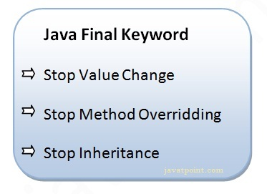
Final keyword
The final keyword in java is used to restrict the user.
We can use final keyword:
variable
method
class

Slide 101
Final variable
class Bike{
final int speedlimit=90; //final variable
void run(){
speedlimit=400;
}
public static void main(String args[]){
Bike obj=new Bike();
obj.run();
}
}
Note: There is a final variable speedlimit, we are going to change the value of this variable, but It can't be changed because final variable once assigned a value can never be changed.

Slide 102
final method
If you make any method as final, you cannot override it.
class Bike{
final void run(){
System.out.println("running");
}
}
class Honda extends Bike{
void run(){
System.out.println("running safely with 100kmph");
}
public static void main(String args[]){
Honda honda= new Honda();
honda.run();
}
}

Slide 103
Final class
If you make any class as final, you cannot extend it.
final class Bike{}
class Honda extends Bike{
void run(){
System.out.println("running safely with 100kmph");
}
public static void main(String args[]){
Honda honda= new Honda();
honda.run();
}
}

Slide 104
Can we initialize blank final variable?
Yes, but only in constructor.
class Bike{
final int speedlimit; //blank final variable
Bike()
{
speedlimit=70;
System.out.println(speedlimit);
}
public static void main(String args[]){
new Bike();
}
}

Slide 105
static blank final variable
A static final variable that is not initialized at the time of declaration is known as static blank final variable. It can be initialized only in static block.
class A{
static final int data; //static blank final variable
static{
data=50;
}
public static void main(String args[]){
System.out.println(A.data);
}
}

Slide 106
Quiz
1. Which of the following approach help us understand better about Real time examples, say Vehicle or Employee of an Organisation?
a) Procedural approach
b) Object Oriented approach
c) Both a and b
2. Which of these keywords is used to make a class?
Class b) struct c) int
3) Which of these statement is incorrect?
a) Every class must contain a main() method.
b) Applets do not require a main() method at all.
c) There can be only one main() method in a program.
d) main() method must be made public

Slide 107
Quiz
4) What is the stored in the object obj in following lines of code? box obj; a) Memory address of allocated memory of object. b) NULL c) Any arbitrary pointer d) Garbage
Explanation: Memory is allocated to an object using new operator. box obj; just
declares a reference to object, no memory is allocated to it hence it points to NULL
5) Which of the following is a valid declaration of an object of class Box? a) Box obj = new Box(); b) Box obj = new Box; c) obj = new Box(); d) new Box obj;

Slide 108
Constructor

Slide 109
Naming Conventions
constructor and overload constructor
method overloading.
abstract class
Concept of Inheritence.
Concept of Packages.
Concept of Interface.
Static Blocks.

Slide 110
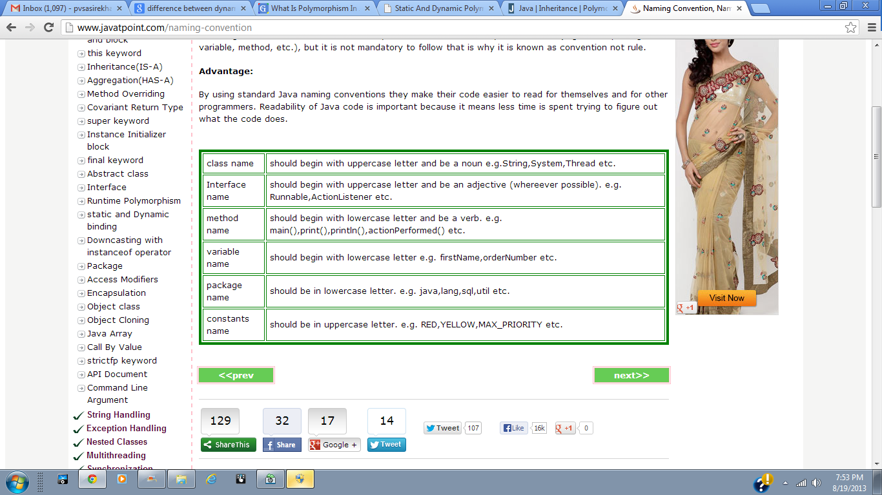
Naming Conventions

Slide 111
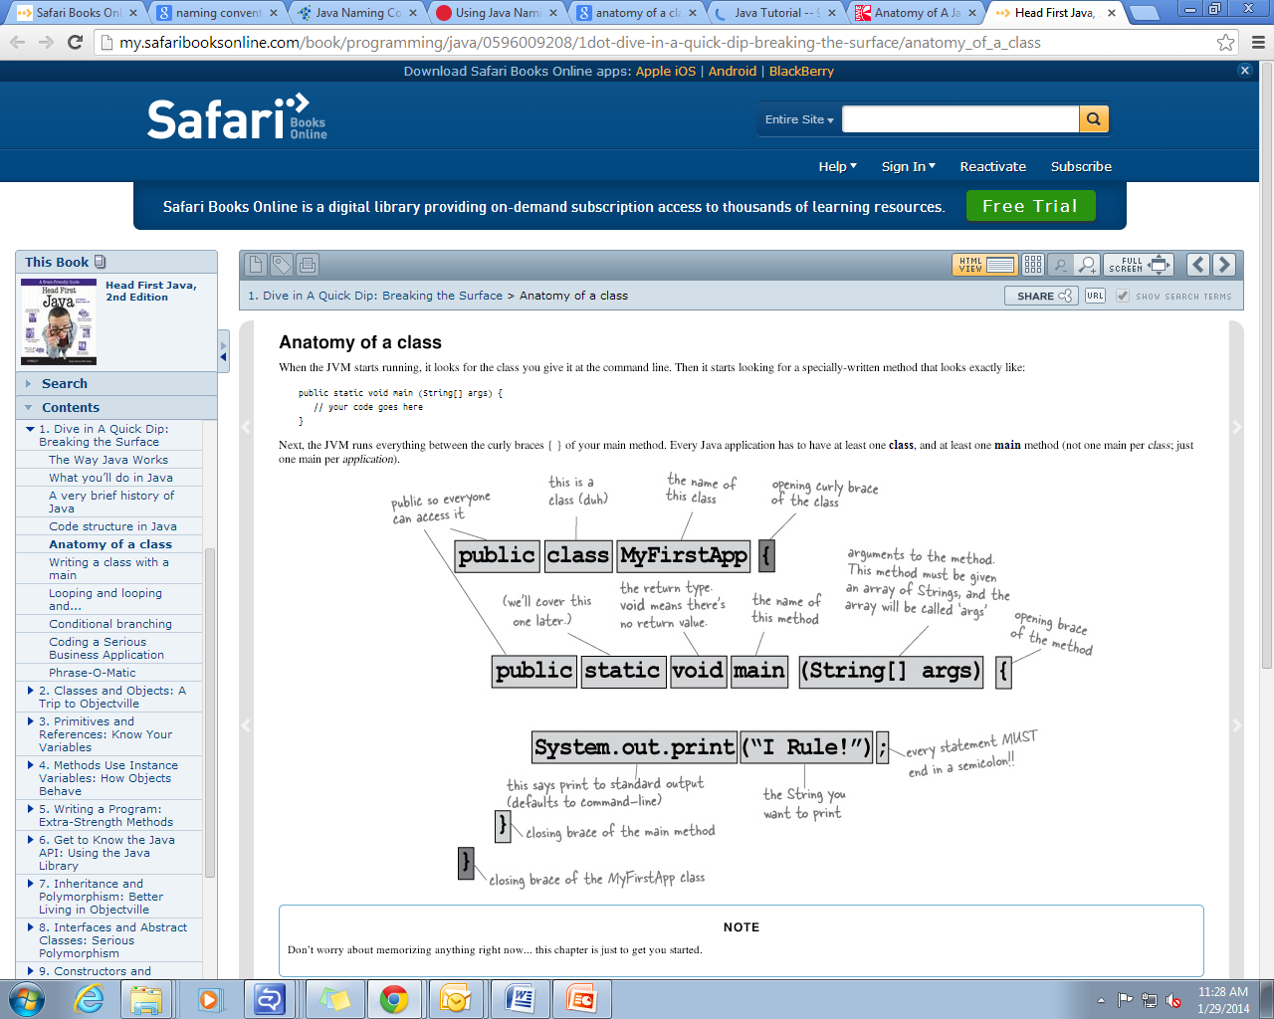
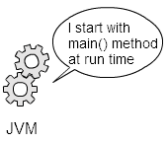
Anatomy of a class

Slide 112
Explanation
class
To declare a class in java.
public
Access modifier which represents visibility. It means visible to all.
static
A keyword.
If we declare a method as static then it is a static method.
The core java advantage of static method is that there is no need to create objects to invoke the static method.
The main method is executed by JVM. So it does not require to create object to invoke the main method. So it saves memory.
Main
Start of a java program. String[] args is used for command line arguments.
System.out.println()
Print statement in java.

Slide 113
Constructor in Java
It is a special type of method.
Initializes an object.
Initialize the instance variable with its default value.
If you don't define a constructor, then the compiler creates a default constructor. Default constructors do not contain any parameters. Default constructors are created only if there are no constructors defined by us.
Use 'this()' to communicate from one constructor to another constructor in the same class.
Use 'super()' to communicate with super class constructor.

Slide 114
Rules
Constructor have the same name as the class itself.
Does not have a return type not even(void).
Constructor is called when an object is created.
Constructor executes only once in objects life cycle.
It can accept arguments.

Slide 115
Types of Constructor
1.Default constructor(no argument constructor)
2.Parameterised constructor(constructor with arguments)

Slide 116
Default Constructor
A constructor that has no parameter.
Syntax:
<classname>(){
//initialize the values.
}

Slide 117
Example
Class Bike{
Bike(){
System.out.println(“Bike is Created”);
}
public static void main(String[] args){
Bike b=new Bike();
}
}
Output: Bike is created.
Rule:
If there is no constructor in a class, compiler automatically creates a default constructor.

Slide 118
constructor with default value
class student{
int id;
String name;
void display(){
System.out.println(id);
System.out.println(name);
}
public static void main(String[] args){
student s1=new student();
student s2=new student();
s1.display();
s2.display();
}
}
Output:In the above class you are not creating any constructor so compiler provides a default constructor.Here 0 and null values are provided by constructor

Slide 119
Parameterised Constructor
Constructor with arguments is said to be Parameterized constructor.

Slide 120
Demo
class student{
int id;
String name;
student(int i, String n) //constructor with arguments
{
Id=i;
name=n;
}
void display(){
System.out.println(id);
System.out.println(name);
}
public static void main(String[] args){
student s1=new student(111,”saran”);
student s2=new student(222,”Ramya”);
s1.display();
s2.display();
}
} output: 111 saran 222 Ramya

Slide 121
Constructor Overloading- Static Polymorphism
More than one constructor in a class with different set of arguments.
We use constructor overloading to initialize each object with different set of values.
constructor overloading can be done only with in the same class.(current class)

Slide 122
Example
class student{
int id;
String name;
int age;
student(int i, String n) //constructor with arguments
{
id=i;
name=n;
}
Student(int i,String n,int a){
Id=i;
name=n;
age=a;
}
void display(){
System.out.println(id);
System.out.println(name);
System.out.println(age);
}
public static void main(String[] args){
student s1=new student(111,”saran”);
student s2=new student(222,”Ramya”,25);
s1.display();
s2.display();
}
}
Output: 111 saran 0
222 Ramya 25

Slide 123
What is the difference between constructor and method?
Constructor | Method
Used to initialize object | Used to expose behaviour of an object
It does not have any return type | It has return type
Invoked implicitly | Invoked Explicitly
Java compiler provides a default constructor. | Method is not provided by compiler
Name of class and constructor should be same | Method name may or may not be same as class name

Slide 124
Method Overloading-Static polymorphism
Method name will be same with different arguments.
Return type of methods should be same.
Method overloading can be done in subclass also.
Advantages:
Increases the readability of the Program

Slide 125
Method overlaoding by changing arguments
class calculation{
void sum(int a, int b)
{
System.out.println(a+b);
}
void sum(int a, int b, int c)
{
System.out.println(a+b+c);
}
public static void main(String[] args){
calculation obj=new calculation();
obj.sum(10,10,10);
obj.sum(20,20);
}
}
Output:30 40
Method overloading

Slide 126
Method overloading by changing data type of arguments
class calculation{
void sum(int a, int b)
{
System.out.println(a+b);
}
void sum(double a, double b)
{
System.out.println(a+b);
}
public static void main(String[] args){
calculation obj=new calculation();
obj.sum(10.5,10.5);
obj.sum(20,20);
}
}
Output:21.0 40

Slide 127
Method overloading is not possible by changing the return type of method.
class calculation{
int sum(int a, int b)
{
System.out.println(a+b);
}
double sum(int a, int b)
{
System.out.println(a+b);
}
public static void main(String[] args){
calculation obj=new calculation();
int result=obj.sum(10,20);
//compile time error becoz it does know which sum method to execute.
}
}

Slide 128
this keyword
In java, this is a reference variable that refers to the current object.
Uses:
this keyword can be used to refer current class instance variable.
this() can be used to invoke current class constructor.
this keyword can be used to invoke current class method (implicitly)
this can be passed as an argument in the method call.
this can be passed as argument in the constructor call.
this keyword can also be used to return the current class instance.

Slide 129
The this keyword can be used to refer current class instance variable.
If there is ambiguity between the instance variable and parameter, this keyword resolves the problem of ambiguity.
Understanding the problem without this keyword
class student{
int id;
String name;
student(int id,String name){
id = id;
name = name;
}
void display(){System.out.println(id+" "+name);}
public static void main(String args[]){
student s1 = new student(111,"Karan");
student s2 = new student(321,"Aryan");
s1.display();
s2.display();
}
}

Slide 130
Note:
In the above example, parameter (formal arguments) and instance variables are same that is why we are using this keyword to distinguish between local variable and instance variable.

Slide 131
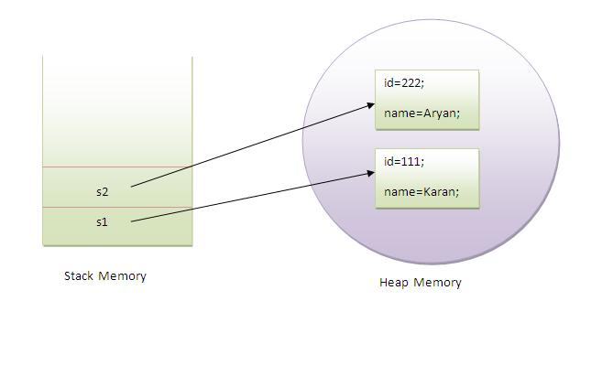
this keyword
class Student{
int id;
String name;
student(int id,String name){
this.id = id;
this.name = name;
}
void display(){System.out.println(id+" "+name);}
public static void main(String args[]){
Student s1 = new Student(111,"Karan");
Student s2 = new Student(222,"Aryan");
s1.display();
s2.display();
}
}

Slide 132
If local variables(formal arguments) and instance variables are different, there is no need to use this keyword like in the following program
class Student{
int id;
String name;
student(int i,String n){
id = i;
name = n;
}
void display(){System.out.println(id+" "+name);}
public static void main(String args[]){
Student e1 = new Student(111,"karan");
Student e2 = new Student(222,"Aryan");
e1.display();
e2.display();
} Output:
111 Karan 222 Aryan
}

Slide 133
this() can be used to invoked current class constructor.
The this() constructor call can be used to invoke the current class constructor (constructor chaining). This approach is better if you have many constructors in the class and want to reuse that constructor
class Student{
int id;
String name;
Student (){System.out.println("default constructor is invoked");}
Student(int id,String name){
this ();//it is used to invoked current class constructor.
this.id = id;
this.name = name;
}
void display(){System.out.println(id+" "+name);}
public static void main(String args[]){
Student e1 = new Student(111,"karan");
Student e2 = new Student(222,"Aryan");
e1.display();
e2.display();
}
}
Output: default constructor is invoked default constructor is invoked 111 Karan 222 Aryan

Slide 134
Where to use this() constructor call?
The this() constructor call should be used to reuse the constructor in the constructor. I
t maintains the chain between the constructors i.e. it is used for constructor chaining.
Let's see the example given below that displays the actual use of this keyword.

Slide 135
Example
class Student{
int id;
String name;
String city;
Student(int id,String name){
this.id = id;
this.name = name;
}
Student(int id,String name,String city){
this(id,name);//now no need to initialize id and name
this.city=city;
}
void display(){System.out.println(id+" "+name+" "+city);}
public static void main(String args[]){
Student e1 = new Student(111,"karan");
Student e2 = new Student(222,"Aryan","delhi");
e1.display();
e2.display();
}
} Note: Call to this() must be the first statement in constructor.
Output:
111 Karan null
222 Aryan delhi

Slide 136
Example
class Student{
int id;
String name;
Student (){System.out.println("default constructor is invoked");}
Student(int id,String name){
id = id;
name = name;
this ();//must be the first statement
}
void display(){System.out.println(id+" "+name);}
public static void main(String args[]){
Student e1 = new Student(111,"karan");
Student e2 = new Student(222,"Aryan");
e1.display();
e2.display();
}
}
Compile time error

Slide 137
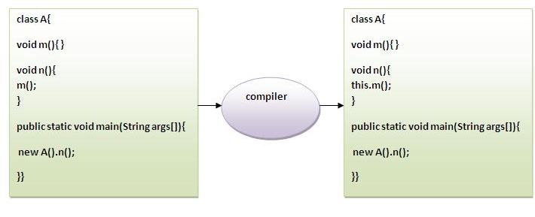
The this keyword can be used to invoke current class method (implicitly).
You may invoke the method of the current class by using the this keyword. If you don't use the this keyword, compiler automatically adds this keyword while invoking the method. Let's see with example

Slide 138
class S{
void m(){
System.out.println("method is invoked");
}
void n(){
this.m();//no need because compiler does it for you.
}
void p(){
n();//complier will add this to invoke n() method as this.n()
}
public static void main(String args[]){
S s1 = new S();
s1.p();
}
}
Output:method is invoked

Slide 139
this keyword can be passed as an argument in the method.
The this keyword can also be passed as an argument in the method. It is mainly used in the event handling.
class S{
void m(S obj){
System.out.println("method is invoked");
}
void p(){
m(this);
}
public static void main(String args[]){
S s1 = new S();
s1.p();
}
}

Slide 140
The this keyword can be passed as argument in the constructor call.
We can pass the this keyword in the constructor also. It is useful if we have to use one object in multiple classes.
class B{
A obj;
B(A obj){
this.obj=obj;
}
void display(){
System.out.println(obj.data);//using data member of A class
}
}
class A{
int data=10;
A(){
B b=new B(this);
b.display();
}
public static void main(String args[]){
A a=new A();
}
}
Output:10

Slide 141
The this keyword can be used to return current class instance.
We can return the this keyword as an statement from the method. In such case, return type of the method must be the class type (non-primitive).
Syntax of this that can be returned as a statement
return_type method_name(){
return this;
}

Slide 142
Example of this keyword that you return as a statement from the method
class A{
A getA(){
return this;
}
void msg(){System.out.println("Hello java");}
}
class Test{
public static void main(String args[]){
new A().getA().msg();
}
}
Hello java

Slide 143
Let's prove that this keyword refers to the current class instance variable. In this program, we are printing the reference variable and this, output of both variables are same
class A{
void m(){
System.out.println(this);//prints same reference ID
}
public static void main(String args[]){
A obj=new A();
System.out.println(obj);//prints the reference ID
obj.m();
} }
Output:A@13d9c02 A@13d9c02

Slide 144
Abstract class in java
Abstraction
Hiding the implementation details and showing only functionality to the user.(i.e) It shows only important things to the user and hides internal details.
Ways to achieve abstraction is:
1.Abstract Class.
2. Interface.

Slide 145
What is Abstract class?
A class that is declared with keyword abstract called abstract class.
It need to be extended and its methods should be implemented.
Abstract class cant be instantiated(i.e object cant be created for this class)

Slide 146
Syntax
abstract classname()
{
//abstract methods
//normal methods
}

Slide 147
Abstract method
A method that is declared with keyword abstract and does not have implementation(body)
Syntax:
abstract returntype methodname();

Slide 148
Example for Abstract class
abstract class Bike{
abstract void run();
}
class Honda extends Bike{
void run()
{
System.out.println("Honda running safely");
}
}
public static void main(String[] args){
Bike obj=new Honda();
obj.run();
}
}
output: Honda running safely
Method without body
Bike class Extended
run() is implemented

Slide 149
Example
abstract class shape{
abstract void draw();
}
class Rectangle extends shape{
void draw(){
System.out.println("Drawing rectangle");
}
}
class circle extends shape{
void draw(){
System.out.println("Drawing cirlce");
}
}
class Test{
public static void main(String[] args){
shape s=new circle();
s.draw();
}
}
Output:Drawing circle

Slide 150
Abstract class having normal method and abstract method
abstract class Bike{
abstract void run();
void changeGear(){
System.out.println("Gear Changed");
}
}
class Honda extends Bike{
void run(){
System.out.println("Runs safely");
}
}
public static void main(String[] args){
Bike b1=new Honda();
b1.run();
b1.changeGear();
}
}
Output:Runs safely
Gear changed

Slide 151
Rules for abstract class
If there is any abstract method in a class then the class should also be declared as
abstract otherwise compiler throws error.

Slide 152
Example
abstract class Bike{
int limit=30;
Bike(){
System.out.println("Constructor is invoked");
abstract void run();
void getDetails(){
System.out.println("It has 2 wheels");
}
}
class Honda extends Bike{
void run(){
System.out.println("Runs safely");
}
}
public static void main(String[] args){
Bike b1=new Honda();
b1.run();
b1.getDetails();
System.out.println(b1.limit);
}
}
Output:Constructor is invoked
Runs safely
It has 2 wheels
30

Slide 153
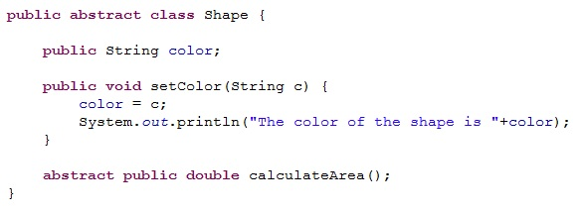
Real time Example

Slide 154
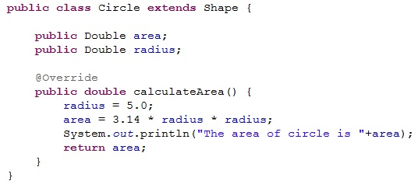

Slide 155
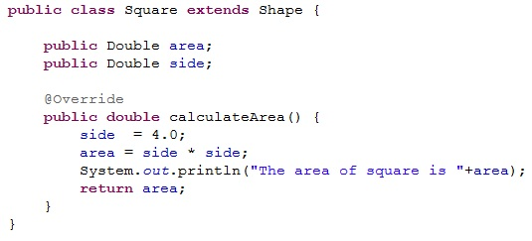

Slide 156
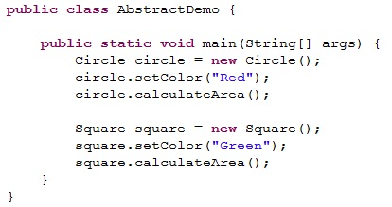

Slide 157
Thank You

